Slide 1

BOOT CAMP 2026
Front End Web Development
Understanding the Networking Foundation of the Web
PRESENTER
DETAILS
Mr. D Obula Raju
Department of CSE
ID: IARE11225
Lecture: 12 • Oct 14, 2026

Slide 2


THE BIG PICTURE
Bridging Front-End and Infrastructure
Beyond UI/UX
Requires mastering data travel mechanics.
Protocol Hierarchy
Strict hierarchy for every API call.
The Complete Journey
From application layer to physical hardware.

Slide 3

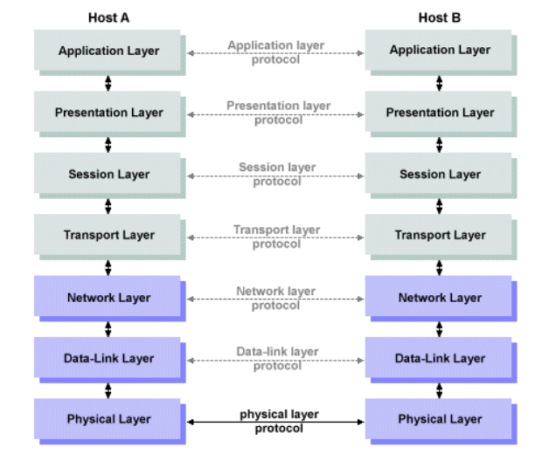
ARCHITECTURE
The OSI Reference Model
Seven distinct layers of network communication mapping data flow.
Layers 7 to 4
Application focus (HTTP, TCP, UDP).
Layers 3 to 1
Infrastructure focus (Routing, Data links).

Slide 4
LAYER 3 OPERATIONS
Identifying Nodes on the Network
Class A
Class B
Class C
Class D/E
0 – 127
128 – 191
192 – 223
224 – 255
Massive global network infrastructure.
Medium regional corporate networks.
Small localized business networks.
Multicast routing and experimental.

Slide 5

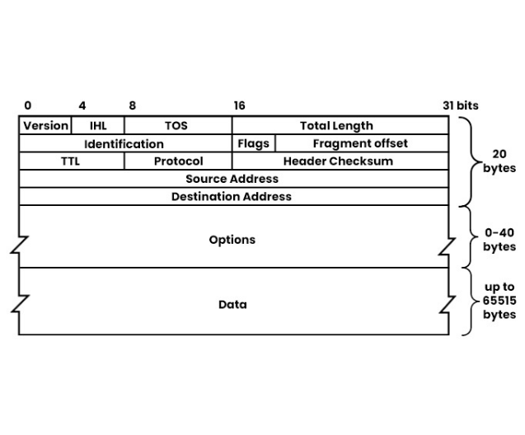
PACKET STRUCTURE
The IPv4 Header
Source Address
Originating node identity.
Destination Address
Target node endpoint.
Time To Live (TTL)
Hop limit to prevent looping.
Protocol
Next level identifier (TCP/UDP).

Slide 6
APPLICATION LAYER
The Language of the Web: Requests
Request Line
METHOD | URL | VERSION
Header Lines
Host: www.iare.ac.in
Accept: text/html, application/json
Authorization: Bearer [token]
Blank Line
Separates metadata from payload
Entity Body
{ "studentId": "IARE11225", "action": "login" }

Slide 7
APPLICATION LAYER
The Server's Reply: Responses
Status Line
VERSION | STATUS CODE | PHRASE
Header Lines
Content-Type: application/json
Content-Length: 342
Cache-Control: max-age=3600
Blank Line
CRLF delimiter
Entity Body
{ "status": "success", "data": { ... } }

Slide 8

Thank You
Questions regarding network fundamentals or modern web workflows?
Mr. D Obula Raju • Department of CSE

Slide 9




Image Sources
https://www.iare.ac.in/sites/default/files/design_templates/IARE_Logo_Academic.png
Source: www.iare.ac.in
https://images.stockcake.com/public/4/c/d/4cd61850-7ee8-480c-ad7c-21dba7c2d769_large/intricate-network-visualization-stockcake.jpg
Source: stockcake.com
https://www.technologyuk.net/telecommunications/telecom-principles/images/osi_1.gif
Source: www.technologyuk.net
https://www.pynetlabs.com/wp-content/uploads/2023/12/ipv4-header-image.jpeg
Source: www.pynetlabs.com

